Slide 1


A new Social Media – Vertical demo
By (Group 12): Ian Coston, Adam Barat, Colton Johnson, Mahri Almazova, Bryan Perdomo

Slide 2
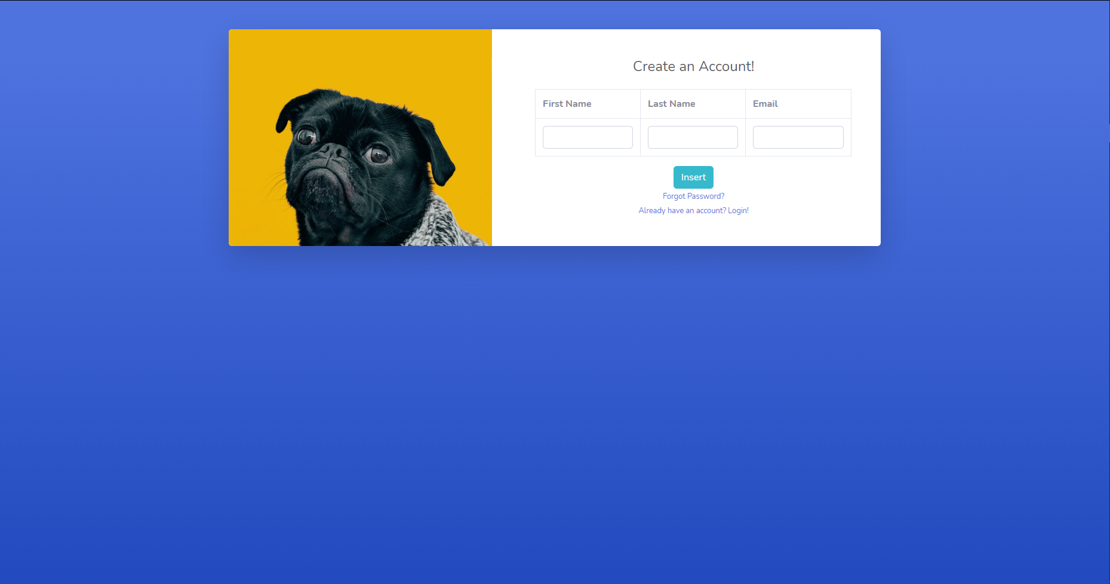
Front End – Registration Screen

Slide 3
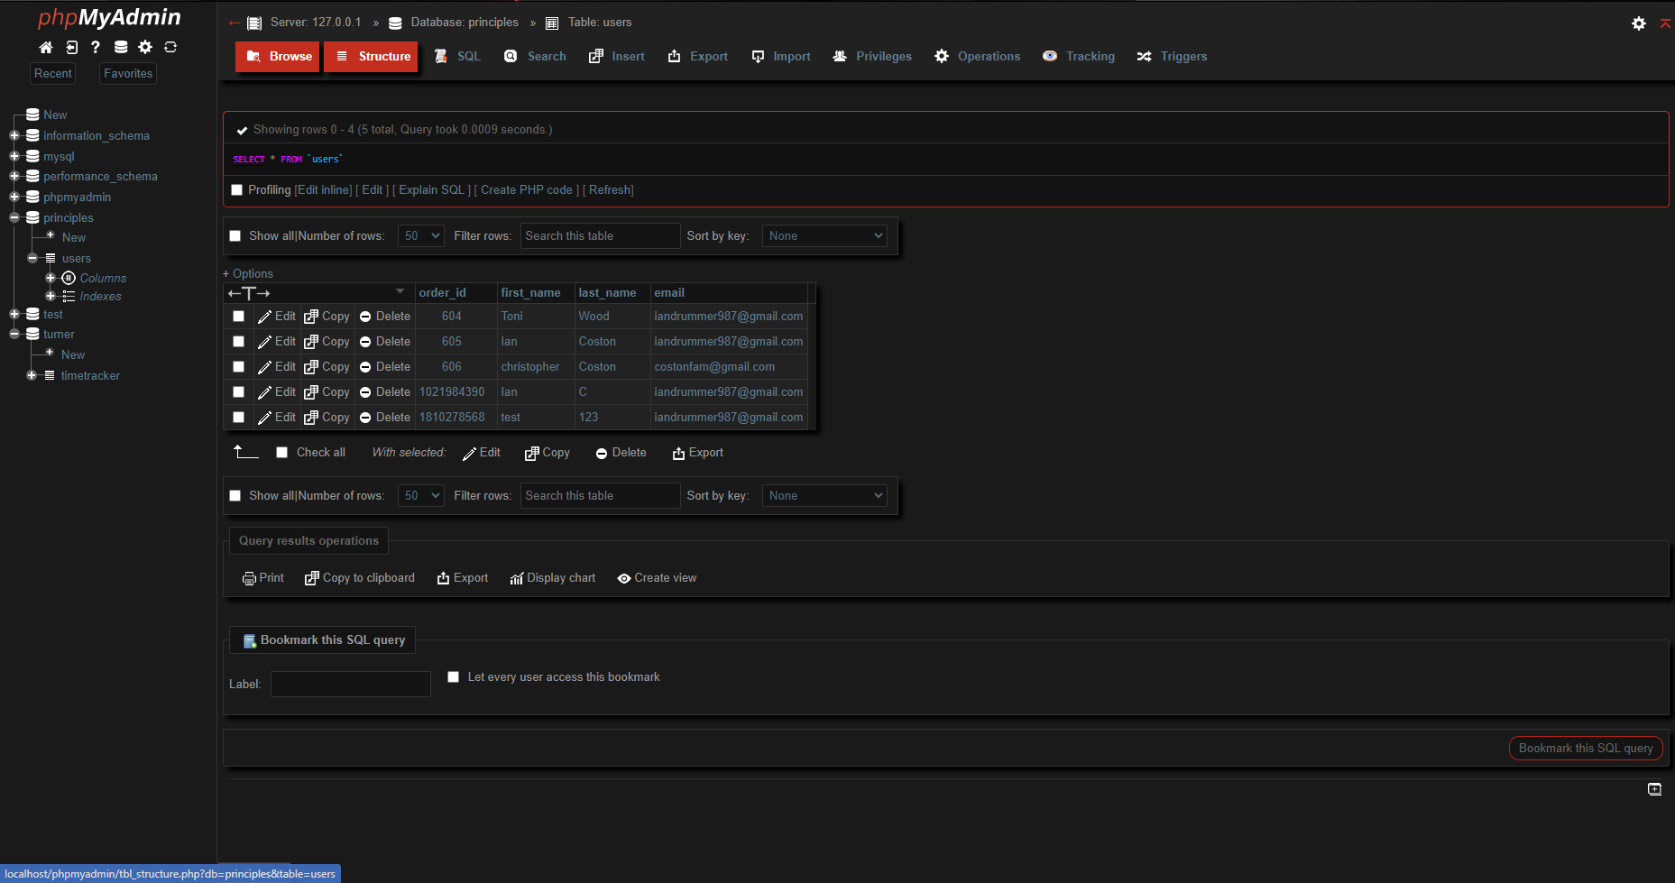
Front End – Registration Screen

Slide 4
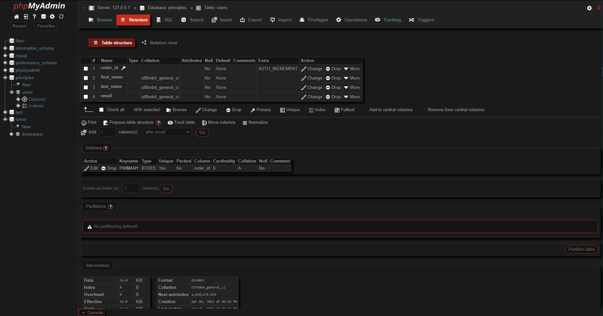
Front End – Registration Screen

Slide 5
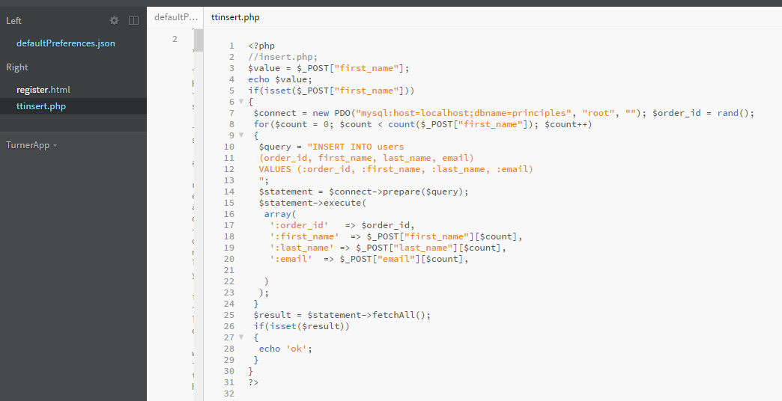
Front End – Registration Screen

Slide 6
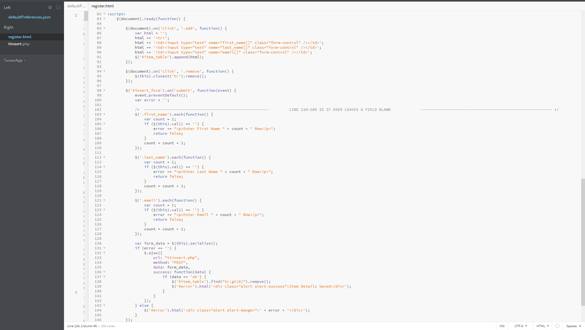
Front End – Registration Screen

Slide 7
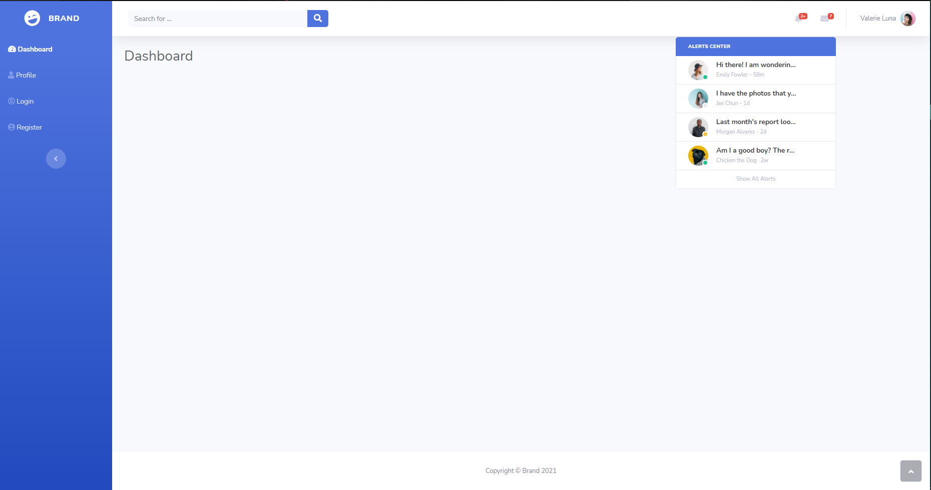
Front End – Registration Screen

Slide 8
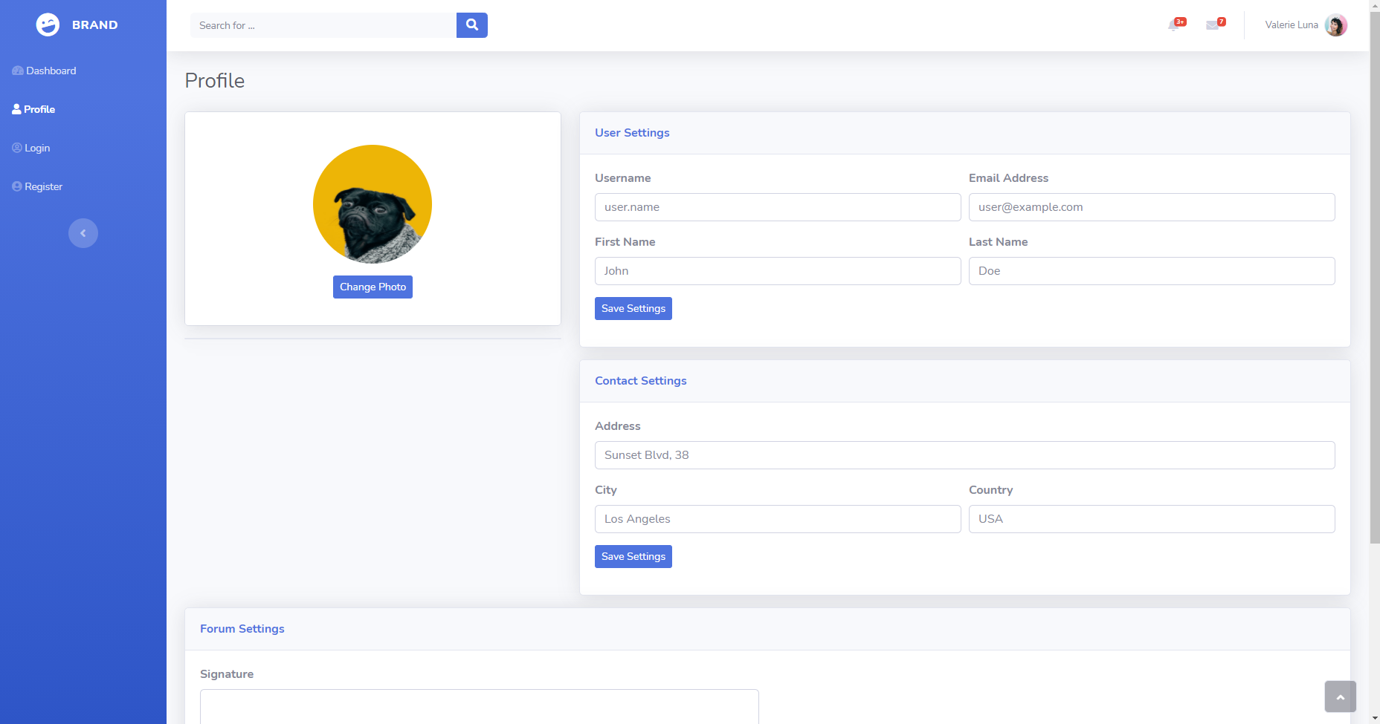
Front End – Registration Screen

